Slide 1




Excess Tools Holdings (EToH) Sdn. Bhd.
Flame Restaurant
Online Menu
By Elven Tan Kean Hong & Tey Sukorn
(SMJK CHUNG LING BUTTERWORTH)

Slide 2

Content
01
02
03
04
05
06
07
Project Information
Project Purpose
Behind the Scenes
Target Audience
Tools and Technologies
Key Features
Future Plans

Slide 3


INTRODUCTION
Project Title and Team Members
Purpose (About the Website, Objective and Reasonings)

Slide 4


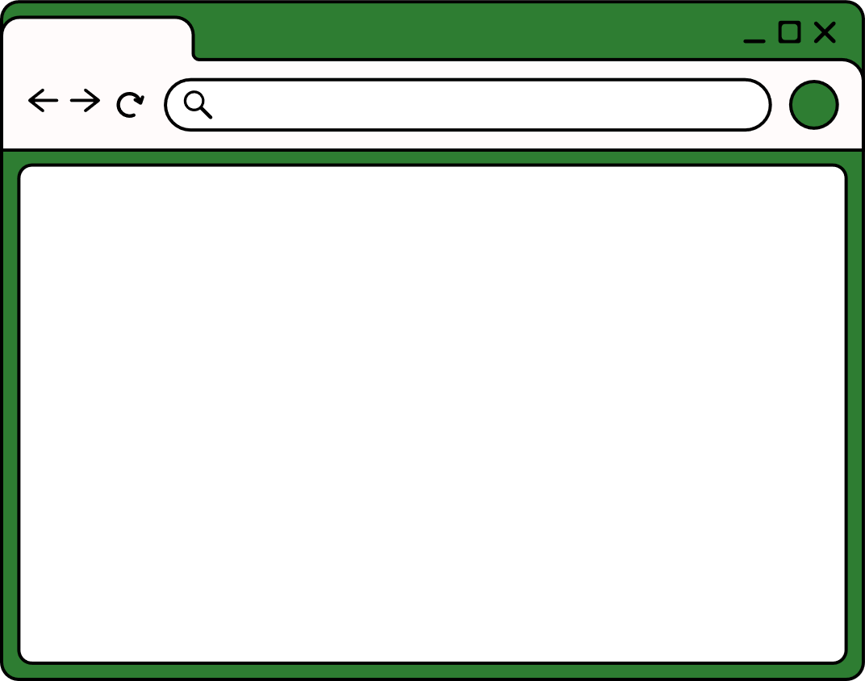



Project Information
Flame Restaurant Online Menu
Elven Tan Kean Hong
Tey Sukorn
Web Developer
Web Designer

Slide 5
Project Information
Flame Restaurant Online Menu is a restaurant themed management system project that made by Excess Tools Holdings (EToH) Sdn. Bhd.
Web Developed by Elven Tan Kean Hong.
Web Designed by Tey Sukorn.
Images are provided from Google Images.

Slide 6
Project Information
Flame Restaurant Online Menu features...
View today's randomly selected menu picks
Browse the full menu with images
Add items to a cart and place orders
Admin panel to view all orders (session-based)
Responsive and modern UI

Slide 7




Purpose
The overall purposes of the website.
Purpose 01
Replace the traditional manual ordering system with a streamlined, digital platform for both customers and staff.
Purpose 02
Allow customers to easily browse the menu, view daily picks, and place orders online.
Excess Tools Holdings (EToH) Sdn. Bhd.
Purpose 03
Enable staff to efficiently view and manage all customer orders through a session-based admin panel.
Purpose 04
Protect the environment by eliminating the use of order record paper for waiters.

Slide 8
CONCEPT
Behind the Scenes
Target Audience

Slide 9
Behind the Scenes
This project’s concept is originally created by Tey Sukorn, have been converted to reality by Elven Tan Kean Hong.
We mostly made this project from our own home, communicating via Discord.
This project started development at Late July 2025, and fully finished at 14 August 2025.
Special thanks to my classmates for supporting this project.

Slide 10


Target Audience
Customers
They can...
Browse the menu easily
Place the orders without waiters
No need to worry about insufficient menu books.

Slide 11

Target Audience
They can...
Access the orders of the customers easily
Staff

Slide 12
DEVELOPMENT
Tools and Technologies
Key Features
Future Plans

Slide 13





HTML
Fundamental structure of website.
CSS
The style and visual
of the website.
Tools & Technologies
We have used several programming languages, frameworks, or tools used to develop the website.
JavaScript
Adds interactivity to
the website.
PHP
Handles Server-Sided
codes like data.

Slide 14




KEY FEATURES
Features that make our website stand out.
Daily’s Picks
Cart System
Admin Panel
Picks the most popular item currently in the Menu.
To summarize your orders and check the total price.
To check the order history and orders of the customers.

Slide 15






Enhancements
01
Dark mode and Light mode
toggle feature, to enhance
user’s experience
02
Add a membership system, alongside with an account
system.
03
Able to use Vouchers on products, by inputting the youcher codes.
04
Overhauling the website, to make the design more appealing.

Slide 16
Excess Tools Holdings (EToH) Sdn. Bhd.
THANK YOU
THE INFORMATION PRESENTED IN THIS SLIDESHOW IS INTENDED FOR INFORMATIONAL PURPOSES ONLY.

